Slide 1
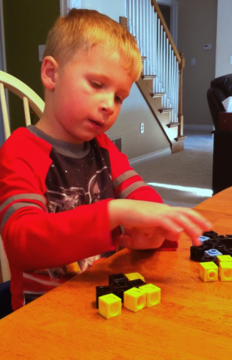
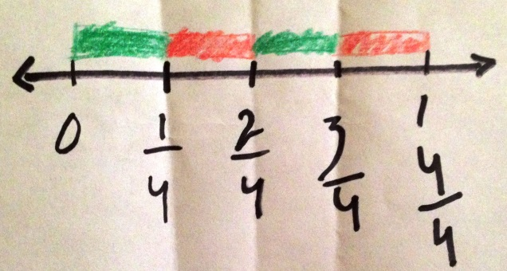
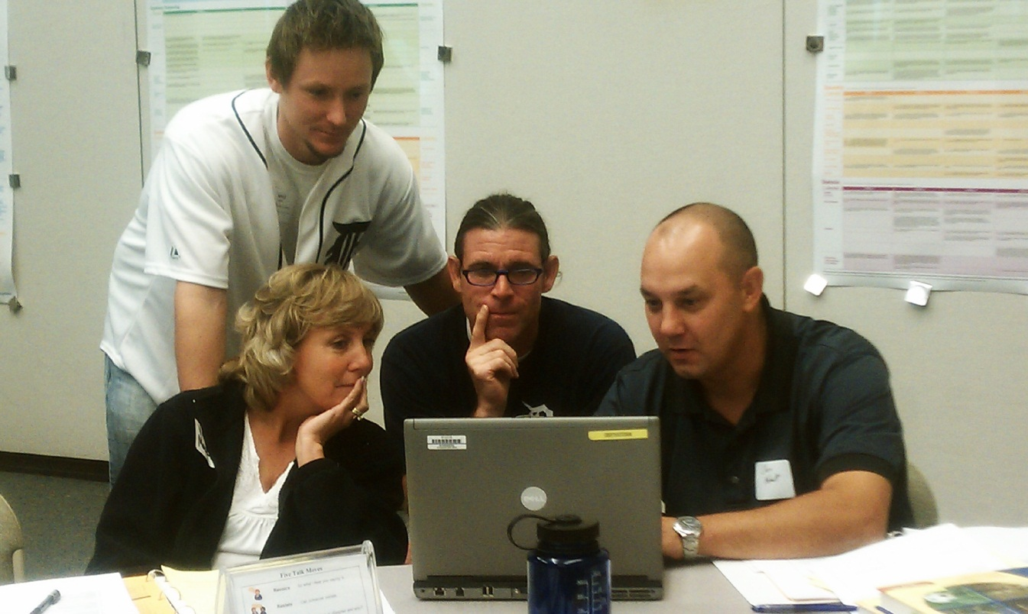
CCSS-M in Michigan

Slide 2
CCSS-M in Michigan
Michigan K-12 Standards
CCSS-M with Michigan “Welcome”
Notes:
http://www.michigan.gov/documents/mde/K-12_MI_Math_Standards_REV_470033_7.pdf
New look for the Michigan standards document

Slide 3
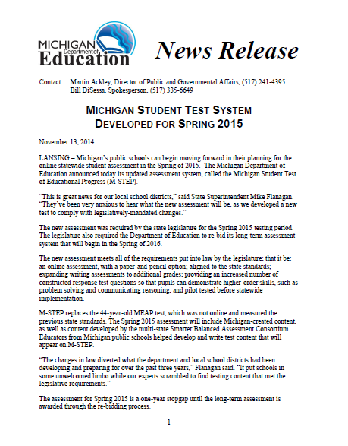
CCSS-M in Michigan
Notes:
Newest documents that we are sharing

Slide 4
MDE News Release November 13, 2014

Slide 5
Assessment Transition MEAP to M-STEP
The new assessment was required by the state legislature for the Spring 2015 testing period. The legislature also required the Department of Education to re-bid its long-term assessment system that will begin in the Spring of 2016.

Slide 6
Assessment Transition
The new assessment meets all of the requirements put into law by the legislature; that it be:
an online assessment, with a paper-and-pencil option;
aligned to the state standards;
expanding writing assessments to additional grades;
providing an increased number of constructed response test questions so that pupils can demonstrate higher-order skills, such as problem solving and communicating reasoning; and
pilot tested before statewide implementation.

Slide 7
Assessment Transition
The Spring 2015 assessment will include Michigan-created content*, as well as content developed by the multi-state Smarter Balanced Assessment Consortium. Educators from Michigan public schools helped develop and write test content that will appear on M-STEP.
* Michigan content will not be included in student scores this year.

Slide 8
Assessment Transition
M-STEP includes the following assessments:
A Spring summative assessment for grades 3-8
A Michigan Merit Exam (MME) for grade 11, which includes a college entrance exam; a work skills component; and a summative component aligned to Michigan content standards
Notes:
Note that this means extended testing for 11th grade students to meet state requirements.
The summative component is NOT a wrap-around as in the past.
No indication at this time of a combined score

Slide 9
Assessment Transition
MDE will be working with the USED to update Michigan’s school accountability model used in its flexibility waiver to the federal No Child Left Behind Act.
In these discussions with USED, it will be the Michigan Department of Education’s intent to use the test data from this transitional year for a trial run of a revised accountability system. It is the intent of the Department that the results of the trial run of accountability would be shared with schools and districts for local decision making, but that no consequences would be applied.

Slide 10
M-STEP Components
The test is comprised of a:
Computer Adaptive Test (CAT),
Classroom Activity, and a
Performance Task (PT).

Slide 11
M-STEP Components
The purpose of the Classroom Activity is to introduce students to the vocabulary and the context of the Performance Task to follow.
The Classroom Activity:
is a 30-minute scripted lesson presented to the students;
should be administered as close as possible, but no more than 3 days prior to the administration of the Performance Task (PT);
may occur on the same day as the PT; and
is delivered in class by the teacher, not online.
Notes:
Slow down

Slide 12
M-STEP Components
The Performance Task (PT) is a multi-item task administered online.
Within this PT students are presented with several stimuli. They will respond to a combination of:
Technology Enhanced (TE) items,
short Constructed Response (CR), and
extended CR items.
Administering the PT without first administering the Classroom Activity is considered a testing irregularity.
Notes:
The paper/pencil administration will also include a PT.
Note: Performance Tasks (and their accompanying classroom activities) are recommended but not required for students in grade 11, as state law prohibits
the requirement of more than one extended-response item on the Michigan Merit Examination. However, because a single extended-response item is likely insufficient to achieve alignment to Michigan’s high school standards, it is unclear whether the U.S. Department of Education will allow results without
Performance Tasks to count for accountability.

Slide 13
M-STEP Components
A “note” about the Performance Task in grade 11...
Performance Tasks (and their accompanying classroom activities) are recommended but not required for students in grade 11, as state law prohibits the requirement of more than one extended-response item on the Michigan Merit Examination.
However, because a single extended-response item is likely insufficient to achieve alignment to Michigan’s high school standards, it is unclear whether the U.S. Department of Education will allow results without Performance Tasks to count for accountability.
Notes:
The paper/pencil administration will also include a PT.
Note: Performance Tasks (and their accompanying classroom activities) are recommended but not required for students in grade 11, as state law prohibits
the requirement of more than one extended-response item on the Michigan Merit Examination. However, because a single extended-response item is likely insufficient to achieve alignment to Michigan’s high school standards, it is unclear whether the U.S. Department of Education will allow results without
Performance Tasks to count for accountability.

Slide 14
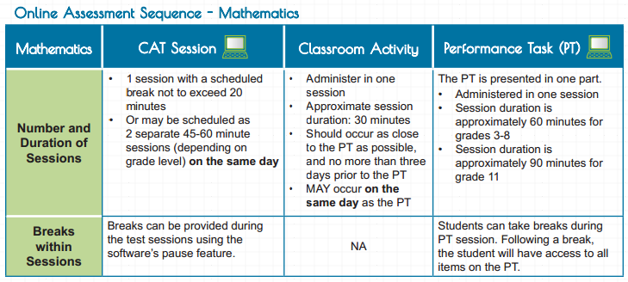
Notes:
Breaks

Slide 15
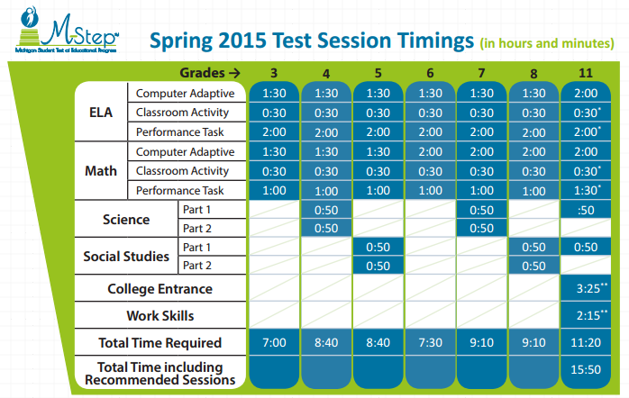
Notes:
*Means optional, can only require 1 extended response type question which already exists on the ACT
**timed test/ paper and pencil

Slide 16
M-Step Spring 15 Preview*
*Grade level specific items to be released in early 2015
https://wbte.drcedirect.com/MI/portals/mi/ott1

Slide 17
Line Guide Tool
Notes:
Sharing this to model the embedded accessibility tools
Line guide tool

Slide 18
Sticky Note Tool
Notes:
Sticky note tool

Slide 19
Sticky Note Tool
10
Notes:
Sticky note tool

Slide 20
Highlight Tool
Notes:
Highlight tool

Slide 21
What do you notice?
Notes:
Sharing because of the structure of the item

Slide 22
Spotlight on Assessment
December 4, 2014
Spotlight
Notes:
Marie

Slide 23
Student Growth
Shift from:
Performance Level Change (PLC) to Student Growth Percentiles (SGPs)
Student Growth Percentiles (SGPs):
help students, parents, and educators determine if a student’s learning is above, near, or below the average of their comparison group;
are not about how high or low the student’s current score is but rather how much learning a student has shown since the prior test.
Critical difference between PLC and SGPs…
Even students with very low test scores can demonstrate high levels of learning over time.

Slide 24
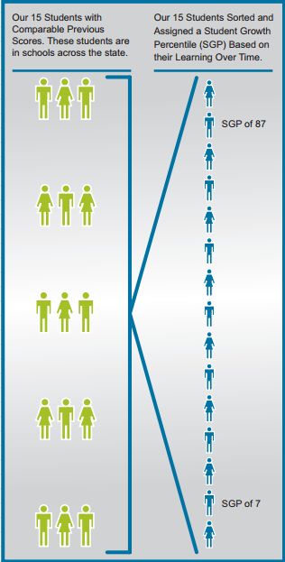
Notes:
Students (or students) at SGP 87 (second position) scored at or better than 87 percent of the students in his or her like cohort.

Slide 25
CCSS-M Communication Resources

Slide 26
Prepare for More Realistic Test Results
Larson, M., & Leinwand, S. (2013). Prepare for More Realistic Test Results. The Mathematics Teacher, 106(9), 656-659.
Notes:
Parent website for CCSS info

Slide 27
Be a Learning Hero
http://www.bealearninghero.org/#intro
Notes:
Parent website for CCSS info

Slide 28
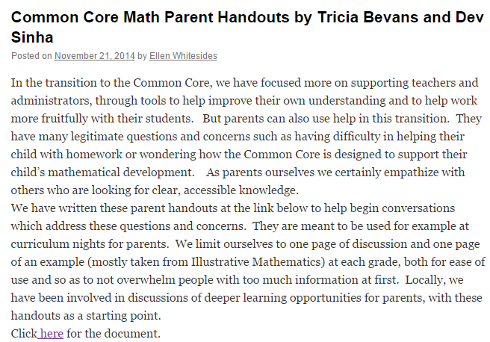
Common Core Math – A Grade-By-Grade View For Parents
http://pages.uoregon.edu/dps/CommonCore/CCSSM_bygrade.pdf
Notes:
Useful for both parents and school districts. Much more in depth about what is happening in each grade level

Slide 29
Language Domains
Listening
Speaking
Reading
Writing
Notes:
Each standards matrix is organized around one of these four language domains.

Slide 30
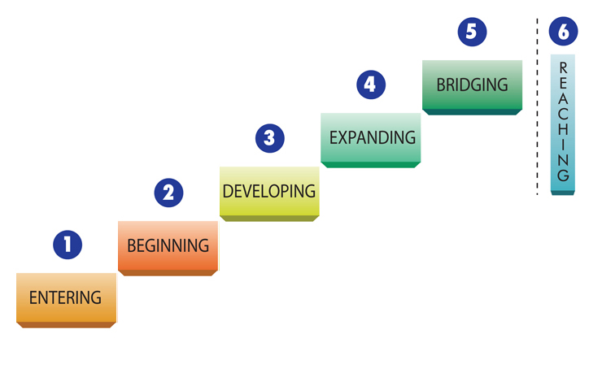
English Language Development Levels
Notes:
30
The labels used for the six proficiency levels were created by the WIDA development team. ELL status is restricted to levels 1 through 5. A student reaching level 6 shows no language characteristics that would distinguish him or her as needing special English language services. Such a student would be capable enough in all language domains: Speaking, Listening, Reading and Writing, to be able to benefit fully from mainstream classroom instruction. Note that a student at a lower level in the policy set by states or school districts may be designated as functionally able to participate in and benefit from regular classroom instruction and may, in fact, be exited from special English language services.

Slide 31
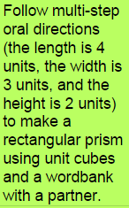
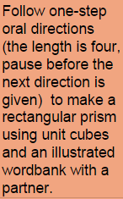
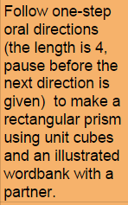
Quality Leveled Instruction

Slide 32
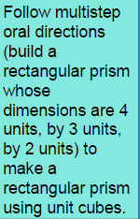
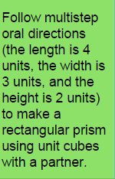
Quality Leveled Instruction

